Slide 1



Dialysis of Patients

Slide 2









- Ishan
- pushpendra singh
- kedar jadav
- vaishanvi tashi
- prakruthi
- komal jain
- harsh

Slide 3
IIntroduction -
Dialysis healthcare analytics involves the analysis of key performance indicators (KPIs) to gain insights and make data driven decisions in the field of dialysis care.
It includes monitoring the number of patients across various summaries, comparing profit vs. non-profit statistics , assessing chain organizations based on total performance scores, analysing dialysis station statistics, examining category text for expected outcomes, and tracking the average payment reduction rate.
By leveraging these analytics , healthcare providers can optimize care delivery , improve operational efficiency , enhance financial performance, and ultimately improve patient outcomes in the dialysis care sector.

Slide 4












TABLE OF CONTENTS
1
KPI 1 Number of Patients across various summaries
2
KPI 2 Profit Vs Non-Profit Stats
01
ALL KPI ANALYSIS
& RECOMMENDATION
3
KPI 3 Chain Organizations w.r.t. Total Performance Score as No Score
4
KPI 4 Dialysis Stations Stats
5
KPI 5 Total Category Text - As Expected
6
KPI 6 Average Payment Reduction Rate
Power bi Dashboard
02
2
Dashboard overview
03
Conclusion
1
Conclusion

Slide 5



01
ALL KPI ANALYSIS & RECOMMENDATIONS

Slide 6







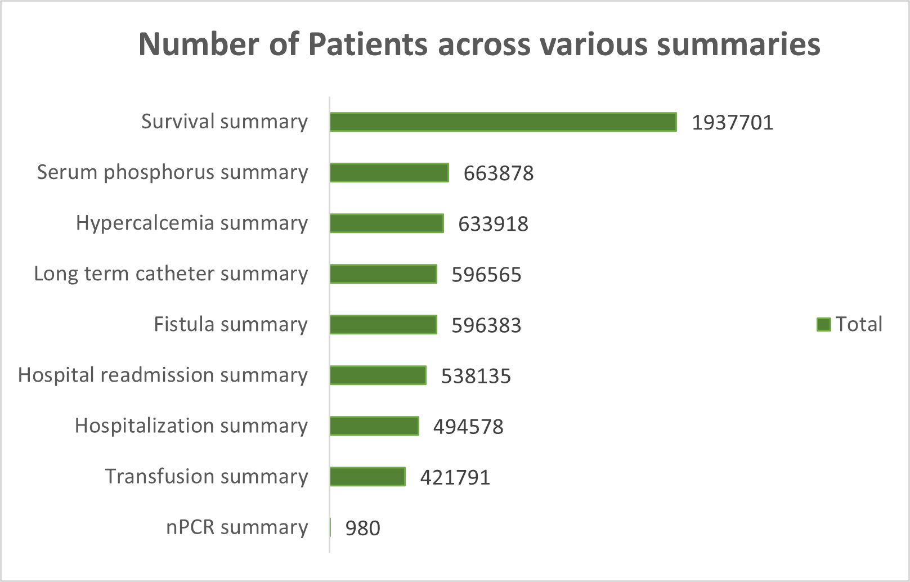





KPI 1 Number of Patients across various summaries
Analysis
The number of patients in different summaries helps tracking the patient population trends, such as the total number of patients, patient demographics, and specific patient summaries (e.g., by age, gender, or medical conditions).
This KPI insights can be used to analyses demand for dialysis services.
It helps in the capacity planning, and thus assists healthcare providers in delivering personalized care based on patient
characteristics.

Slide 7


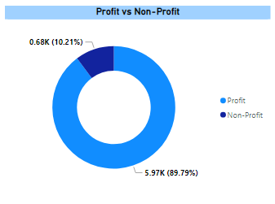
This analysis involves examining key financial metrics, such as revenue, expenses, profit margins, and return on investment, to understand the economic landscape of the dialysis care sector.
This analysis can help to find differences in financial outcomes of profit and non-profit organizations and enables stakeholders to make informed decisions regarding sustainability of care, cost management, and resource allocation.

Slide 8


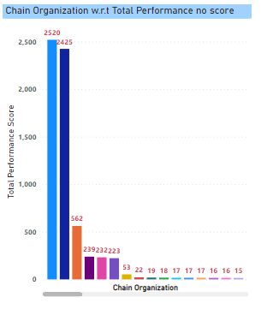

The total performance score depicts efficiency through various quality measures, patient outcomes, and adherence to best practices.
The total performance score with respect to chain organizations helps healthcare providers to identify areas of improvement, benchmark against industry standards, and promote quality care delivery across different chains.

Slide 9
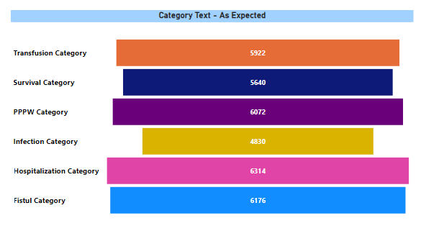
KPI 4 Dialysis Stations Stats
The ratings of dialysis center can be used to compare dialysis facilities (centers) based on the quality of patient care they provide. This can be used to compare their patient experience survey results.
This KPI helps to analyse number of dialysis stations, their utilization rates, availability, and efficiency of operations.
By these statistics, healthcare providers can optimize:
Areas of underutilization or overcrowding identification.
Equitable access to dialysis services
Improve operational efficiency in delivering care
Resource allocation

Slide 10

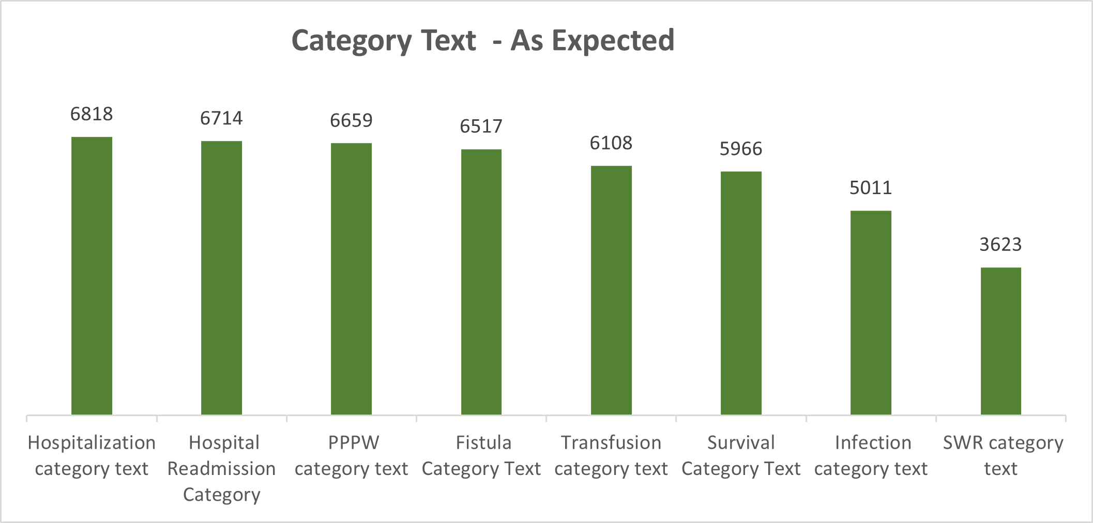

KPI 5 Total Category Text – As Expected
Analysis
This categorizing of patients maintains specific criteria which helps examining their outcomes.
This analysis helps hospitals to prioritize the services provided to the patients on the basis of category alloted.
These outcomes when compared with expectations can help healthcare providers assess the effectiveness of different treatment plans, identify patterns, and tailor care strategies to specific patient categories, ultimately improving the quality of care provided.

Slide 11


KPI 6 Average Payment Reduction Rate
This KPI helps to identify
reimbursements, contractual
agreements and insurance related statistics.
The hospitals and healthcare providers can analyze their financial status and plan strategies for their revenue.
This KPI can help to decide the costs of dialysis which vary widely according to many factors and conditions.
This can help to regulate the additional costs with dialysis
e.g physician fees, diagnostics, medicines and hospitalizations.
On this basis hospitalization costs and total expenditures for dialysis patients can be fixed.

Slide 12


02
DASHBOARDS OR SCREENSHOTS

Slide 13



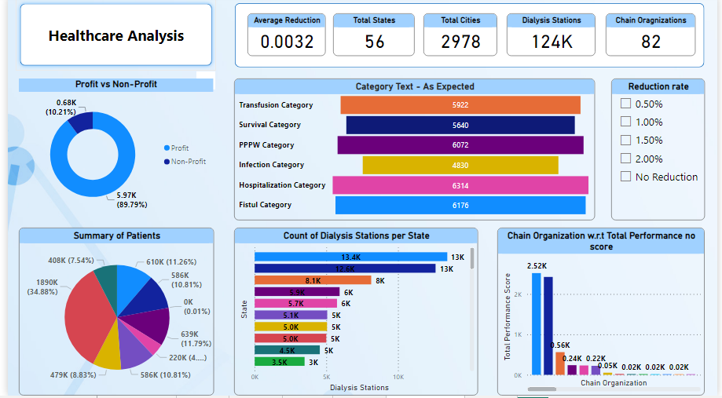
Power Bi Dashboard

Slide 14
Dashboard overview -
Overall the dialysis healthcare analytics dashboard in power bi provides healthcare providers with a comprehensive view of key metrics and trends in the dialysis care sectors.
By leveraging the interactive capabilities of power bi , stakeholders can make data-driven decisions, optimize care delivery, improve operational efficiency, and enhance patient outcomes.

Slide 15
Conclusion -
Survival summary has the highest patient count. indicating positive outcomes ,while npcr summary has the lowest count.
The count of profitable facilities decreased from 2018 to 2020.signaling a concerning trend. Davita and Fresenius Medical C are have a majority of profitable facilities.
Approximately 88.75% of facilities generate profit , while non-profit facilities need analysis.
The highest performance score was recorded in 1969,while the lowest was in 1971.
Intermountain healthcare and memorial Hermann have high performance scores , while others need improvement.
The number of dialysis stations increased until 2018 and then started declining , which is concerning.

Slide 16
The survival category has a good patient count , while hospitalization has the highest count.
Implementing cost containment strategies like operational efficiency improvements and optimizes supply chain management can reduce costs.
Transitioning to value-based care models and leveraging technology and innovation can optimize healthcare delivery and potentially reduce payments.
Quality improvement initiatives , such as reducing readmissions and preventing medical errors , can lead to cost savings and better payment rates.

Slide 17












THANK YOU!

